Slide 1

An Intelligent Phishing Website Detection System Using Machine Learning for Enhanced Web Security
CSA5117 – Cryptography and Network Security
Course Faculty : Dr. R. Dharani, Professor/Edge Computing,
SIMATS Engineering, SIMATS
192311228 | T SANHITH
192565085 | DANIEL JESURAJI J
192312208 | SHAIK SHOUIB AKTHAR
7/29/2026
CAPSTONE PROJECT
1

Slide 2

AGENDA
Introduction
Literature Review
Problem Statement
Objectives
Proposed Methodology
Dataset Description
Machine Learning Model
Results & Discussion
Applications
Future Enhancements
Conclusion
7/29/2026
CAPSTONE PROJECT
2

Slide 3
ABSTRACT
The rapid growth of online services has increased phishing attacks that steal sensitive user information through fake websites.
This project proposes an intelligent phishing website detection system using Machine Learning.
The system analyses website features extracted from URLs and webpage properties to classify websites as Legitimate or Phishing.
It also provides:
Risk Score (0–100)
Confidence Score
Human-readable explanations
Chrome Extension for real-time detection
The objective is to improve cybersecurity and protect users from phishing attacks.
7/29/2026
CAPSTONE PROJECT
3

Slide 4
INTRODUCTION
Phishing is a cyberattack where attackers create fake websites that imitate legitimate websites to steal sensitive user information such as usernames, passwords, banking credentials, and personal data.
With the rapid growth of online banking, e-commerce, and digital services, phishing attacks have become more sophisticated and difficult to detect.
Traditional phishing detection methods, such as blacklist-based systems, are ineffective against newly created (zero-day) phishing websites.
Machine Learning enables intelligent detection by analyzing various website characteristics and identifying phishing websites based on learned patterns rather than relying only on known malicious URLs.
7/29/2026
CAPSTONE PROJECT
4

Slide 5
INTRODUCTION
Need for the Proposed System
Develop an intelligent phishing website detection system using Machine Learning algorithms.
Analyze multiple website features such as URL structure, domain information, HTML content, and webpage characteristics.
Predict whether a website is Legitimate or Phishing with high accuracy.
Provide Explainable AI (SHAP) to help users understand why a website was classified as phishing.
Generate a Risk Score (0–100) and Confidence Score for better decision-making.
Deploy the solution as a FastAPI web application and Chrome Extension for real-time phishing detection.
7/29/2026
CAPSTONE PROJECT
5

Slide 6
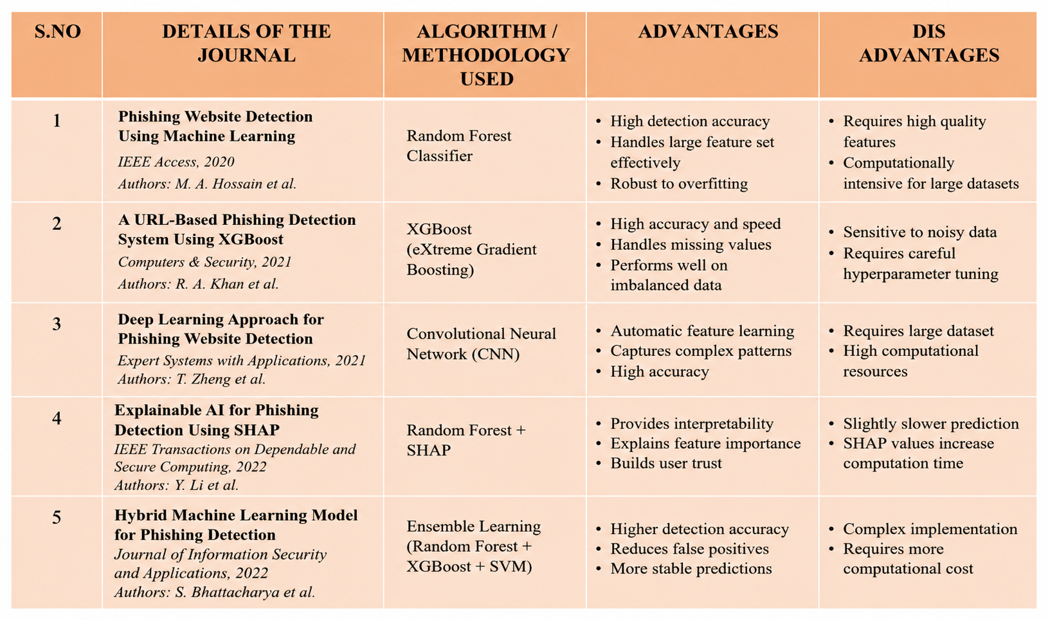
LITERATURE REVIEW
7/29/2026
CAPSTONE PROJECT
6

Slide 7
PROBLEM STATEMENT
Phishing websites are increasing rapidly and pose serious cybersecurity threats.
Traditional blacklist and rule-based methods fail to detect newly created phishing websites.
Existing systems lack transparency and do not explain their predictions.
There is a need for a real-time, accurate, and explainable phishing detection system using Machine Learning.
7/29/2026
CAPSTONE PROJECT
7

Slide 8
OBJECTIVES OF THE CAPSTONE PROJECT
Develop a Machine Learning-based phishing website detection system. Improve phishing detection accuracy using advanced ML algorithms.
Perform feature engineering and model optimization on the PhiUSIIL dataset. Provide explainable predictions using SHAP.
Generate confidence and risk scores for each website.
Develop a web application and Chrome Extension for real-time phishing detection.
7/29/2026
CAPSTONE PROJECT
8

Slide 9
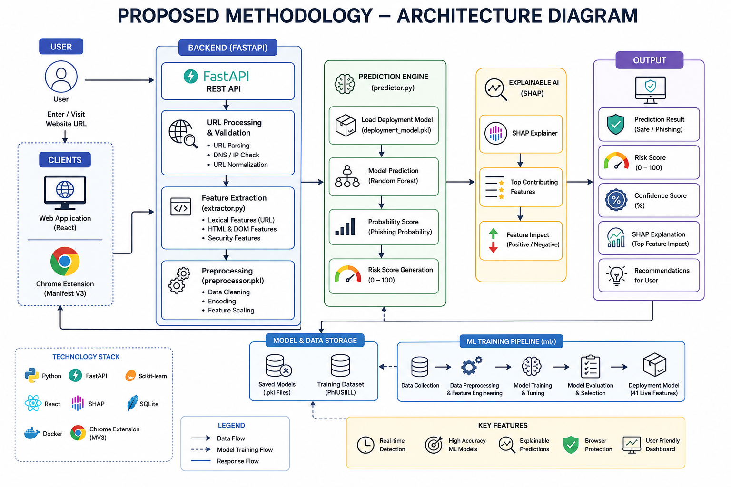
7/29/2026
CAPSTONE PROJECT
9

Slide 10
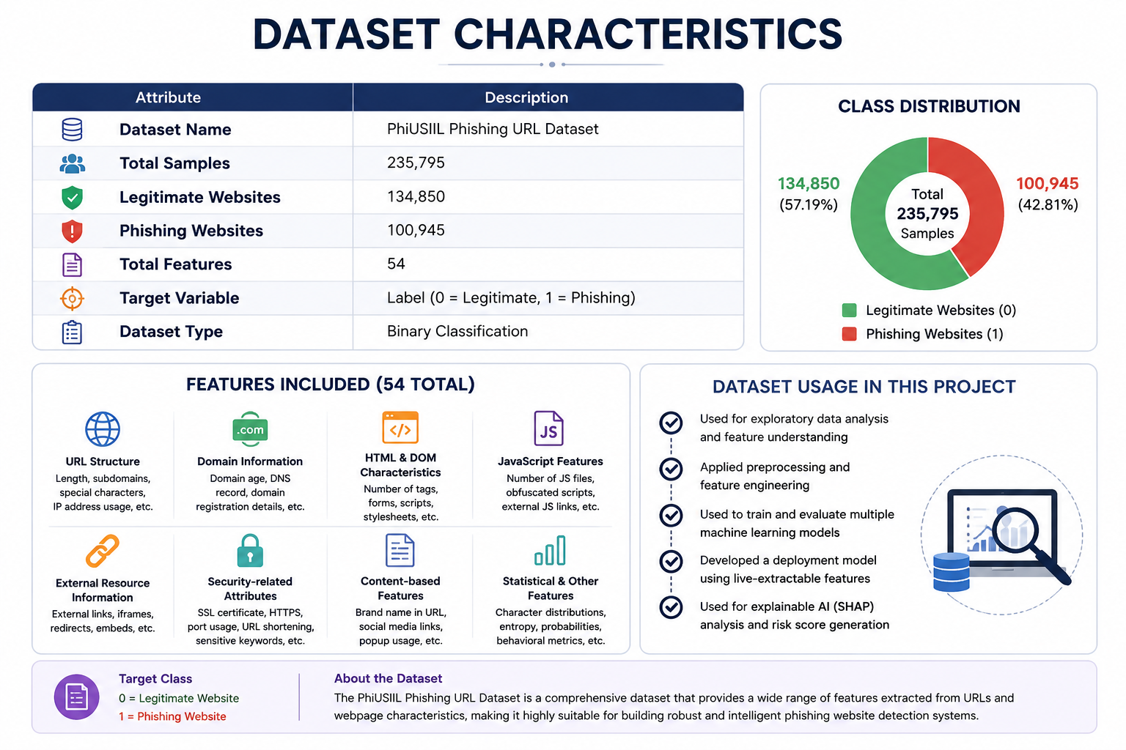
DESCRIPTION ABOUT THE DATASETS USED
The PhiUSIIL Phishing URL Dataset is a publicly available cybersecurity dataset designed for phishing website detection using Machine Learning techniques.
It contains a comprehensive collection of legitimate and phishing websites, along with 54 website-related features extracted from URLs, webpage structure, and security characteristics.
The dataset includes 235,795 website samples, consisting of approximately 134,850 legitimate websites and 100,945 phishing websites, making it suitable for supervised classification tasks.
7/29/2026
CAPSTONE PROJECT
10

Slide 11
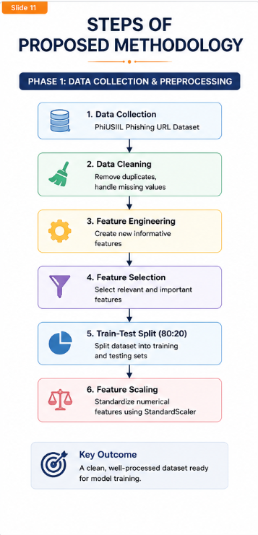
Module 1: Data Collection & Preprocessing
Load the PhiUSIIL Phishing URL Dataset.
Perform data cleaning by handling missing values and duplicate records.
Apply feature engineering to improve feature quality.
Select relevant features for model training. Split the dataset into training and testing sets.
Standardize numerical features using StandardScaler.
7/29/2026
CAPSTONE PROJECT
11

Slide 12
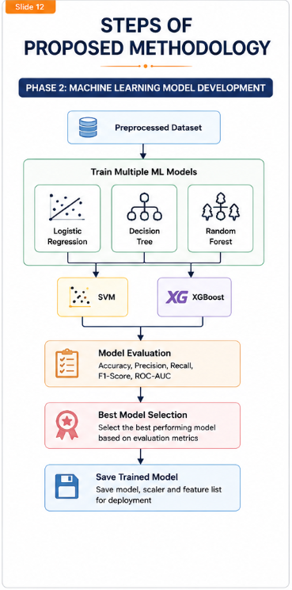
Module : 2 Machine Learning Model Development
Train multiple Machine Learning algorithms. Compare model performance. Evaluate using: Accuracy
Precision
Recall
F1-Score
ROC-AUC
Select the best-performing model. Save the trained model for deployment.
7/29/2026
CAPSTONE PROJECT
12

Slide 13
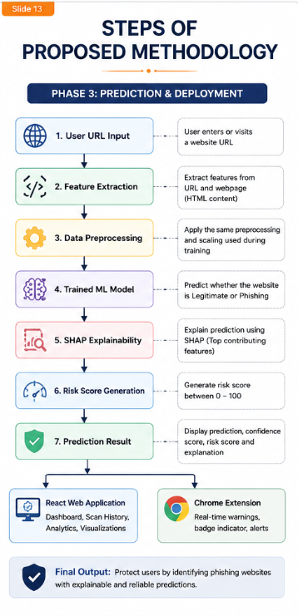
Module :3 Prediction & Deployment
Accept website URL from the user. Extract real-time URL and webpage features.
Preprocess the extracted features. Predict whether the website is Legitimate or Phishing.
Generate Confidence Score and Risk Score (0–100).
Explain predictions using SHAP Explainable AI.
Display results through the React Web Application and Chrome Extension.
7/29/2026
CAPSTONE PROJECT
13

Slide 14
RESULTS AND DISCUSSION
1 POINT
1 POINT
1 POINT
1 POINT
7/29/2026
CAPSTONE PROJECT
14

Slide 15
RESULTS AND DISCUSSION
1 POINT
1 POINT
1 POINT
1 POINT
7/29/2026
CAPSTONE PROJECT
15

Slide 16
PROJECT DEMO
7/29/2026
CAPSTONE PROJECT
16

Slide 17
APPLICATIONS OF THE RESEARCH
1. Banking & Financial Security
Detect phishing websites targeting online banking and digital payment platforms.
Protect customers from credential theft and financial fraud.
2. E-Commerce Platforms
Identify fake shopping websites before users make transactions.
Improve customer trust and reduce online payment scams.
3. Enterprise Cybersecurity
Integrate with organizational security systems to prevent employees from accessing malicious websites.
Strengthen corporate cybersecurity policies.
4. Browser Security
Deploy as a Chrome Extension to provide real-time phishing detection while browsing.
Alert users instantly with risk scores and warning messages.
7/29/2026
CAPSTONE PROJECT
17

Slide 18
CONCLUSION
Successfully developed an intelligent phishing website detection system using Machine Learning.
Applied data preprocessing, feature engineering, and model evaluation to build an effective prediction model. Integrated Explainable AI to provide transparent and interpretable predictions.
Implemented the solution using a FastAPI backend, React web application, and Chrome Extension for real-time detection.
Demonstrated the potential of AI-driven cybersecurity solutions for protecting users against phishing attacks.
7/29/2026
CAPSTONE PROJECT
18

Slide 19
FUTURE ENHANCEMENTS
1. Deep Learning Integration
Implement advanced Deep Learning models such as CNNs, LSTMs, or Transformers to improve phishing detection on more complex websites.
2. Real-Time Threat Intelligence
Integrate external cybersecurity threat feeds to continuously update phishing detection capabilities.
3. Multi-Browser Extension Support
Extend the solution beyond Google Chrome to support Microsoft Edge, Mozilla Firefox, and other Chromium-based browsers.
4. Cloud-Based Deployment
Deploy the application on cloud platforms such as AWS, Microsoft Azure, or Google Cloud for scalable and reliable access.
7/29/2026
CAPSTONE PROJECT
19

Slide 20
REFERENCES
H. Zhu, Y. Zhang, and X. Liu, "PhiUSIIL Phishing URL Dataset," University of Illinois, Public Cybersecurity Dataset, 2023.
F. Pedregosa et al., "Scikit-learn: Machine Learning in Python," Journal of Machine Learning Research, vol. 12, pp. 2825–2830, 2011.
S. M. Lundberg and S.-I. Lee, "A Unified Approach to Interpreting Model Predictions," Advances in Neural Information Processing Systems (NeurIPS), 2017.
T. Chen and C. Guestrin, "XGBoost: A Scalable Tree Boosting System," Proceedings of the 22nd ACM SIGKDD International Conference on Knowledge Discovery and Data Mining, pp. 785–794, 2016.
L. Breiman, "Random Forests," Machine Learning, vol. 45, no. 1, pp. 5–32, 2001.
7/29/2026
CAPSTONE PROJECT
20

Slide 21
THANK YOU
7/29/2026
CAPSTONE PROJECT
21

